Slide 1
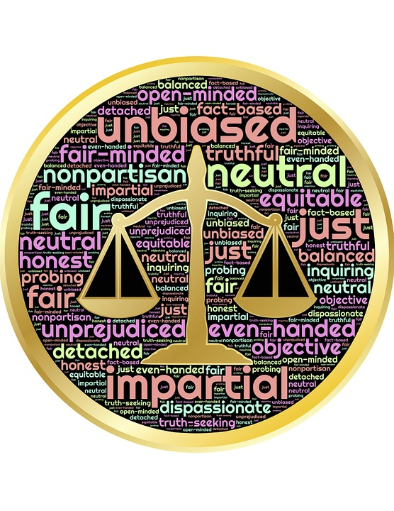
impartial LOVE
Reverend Dawn Salary
Second Baptist Church East End
Newport News, VA 23607

Slide 2
Impartial Love
Bible Background:
James 2
Printed Text:
James 2: 1-13
Devotional Reading:
Matthew 12:1-8
This Photo by Unknown Author is licensed under CC BY-NC

Slide 3
Aim for Change
UNDERSTAND
Understand the difference between showing partiality and treating others equally
AFFIRM
Affirm that all people are equally valued and loved by God
PRACTICE
Practice James’s call to fulfill the “royal law” of loving one’s neighbor as oneself

Slide 4
Keep in Mind
“Listen to me, dear brothers and sisters. Hasn’t God chosen the poor in this world to be rich in faith?
Aren’t they the ones who will inherit the Kingdom He promised to those who love Him?”
(James 2:5 NLT )

Slide 5
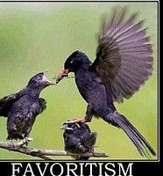
Exhortation Against Favoritism (James 2:1-7)
What does our faith have to do with favoritism towards others?
Why does James say that “discrimination against the poor is guided by evil motives?”
What’s your interpretation of verses 6-7?
This Photo by Unknown Author is licensed under CC BY-SA-NC

Slide 6
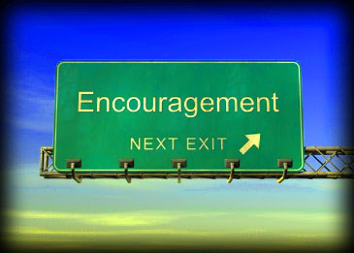
Encouragement to Love (James 2:8-13)
Historically, what are some ways that we’ve shown partiality/favoritism towards “notable” individuals within the church setting?
Reconcile/explain 1 Thessalonians 5:12-13 with today’s lesson?
How can verses 10-11 best be summarized?
What does James mean by the law of liberty/the law that sets you free?
What’s the penalty for not showing mercy towards others?
This Photo by Unknown Author is licensed under CC BY-NC-ND

Slide 7
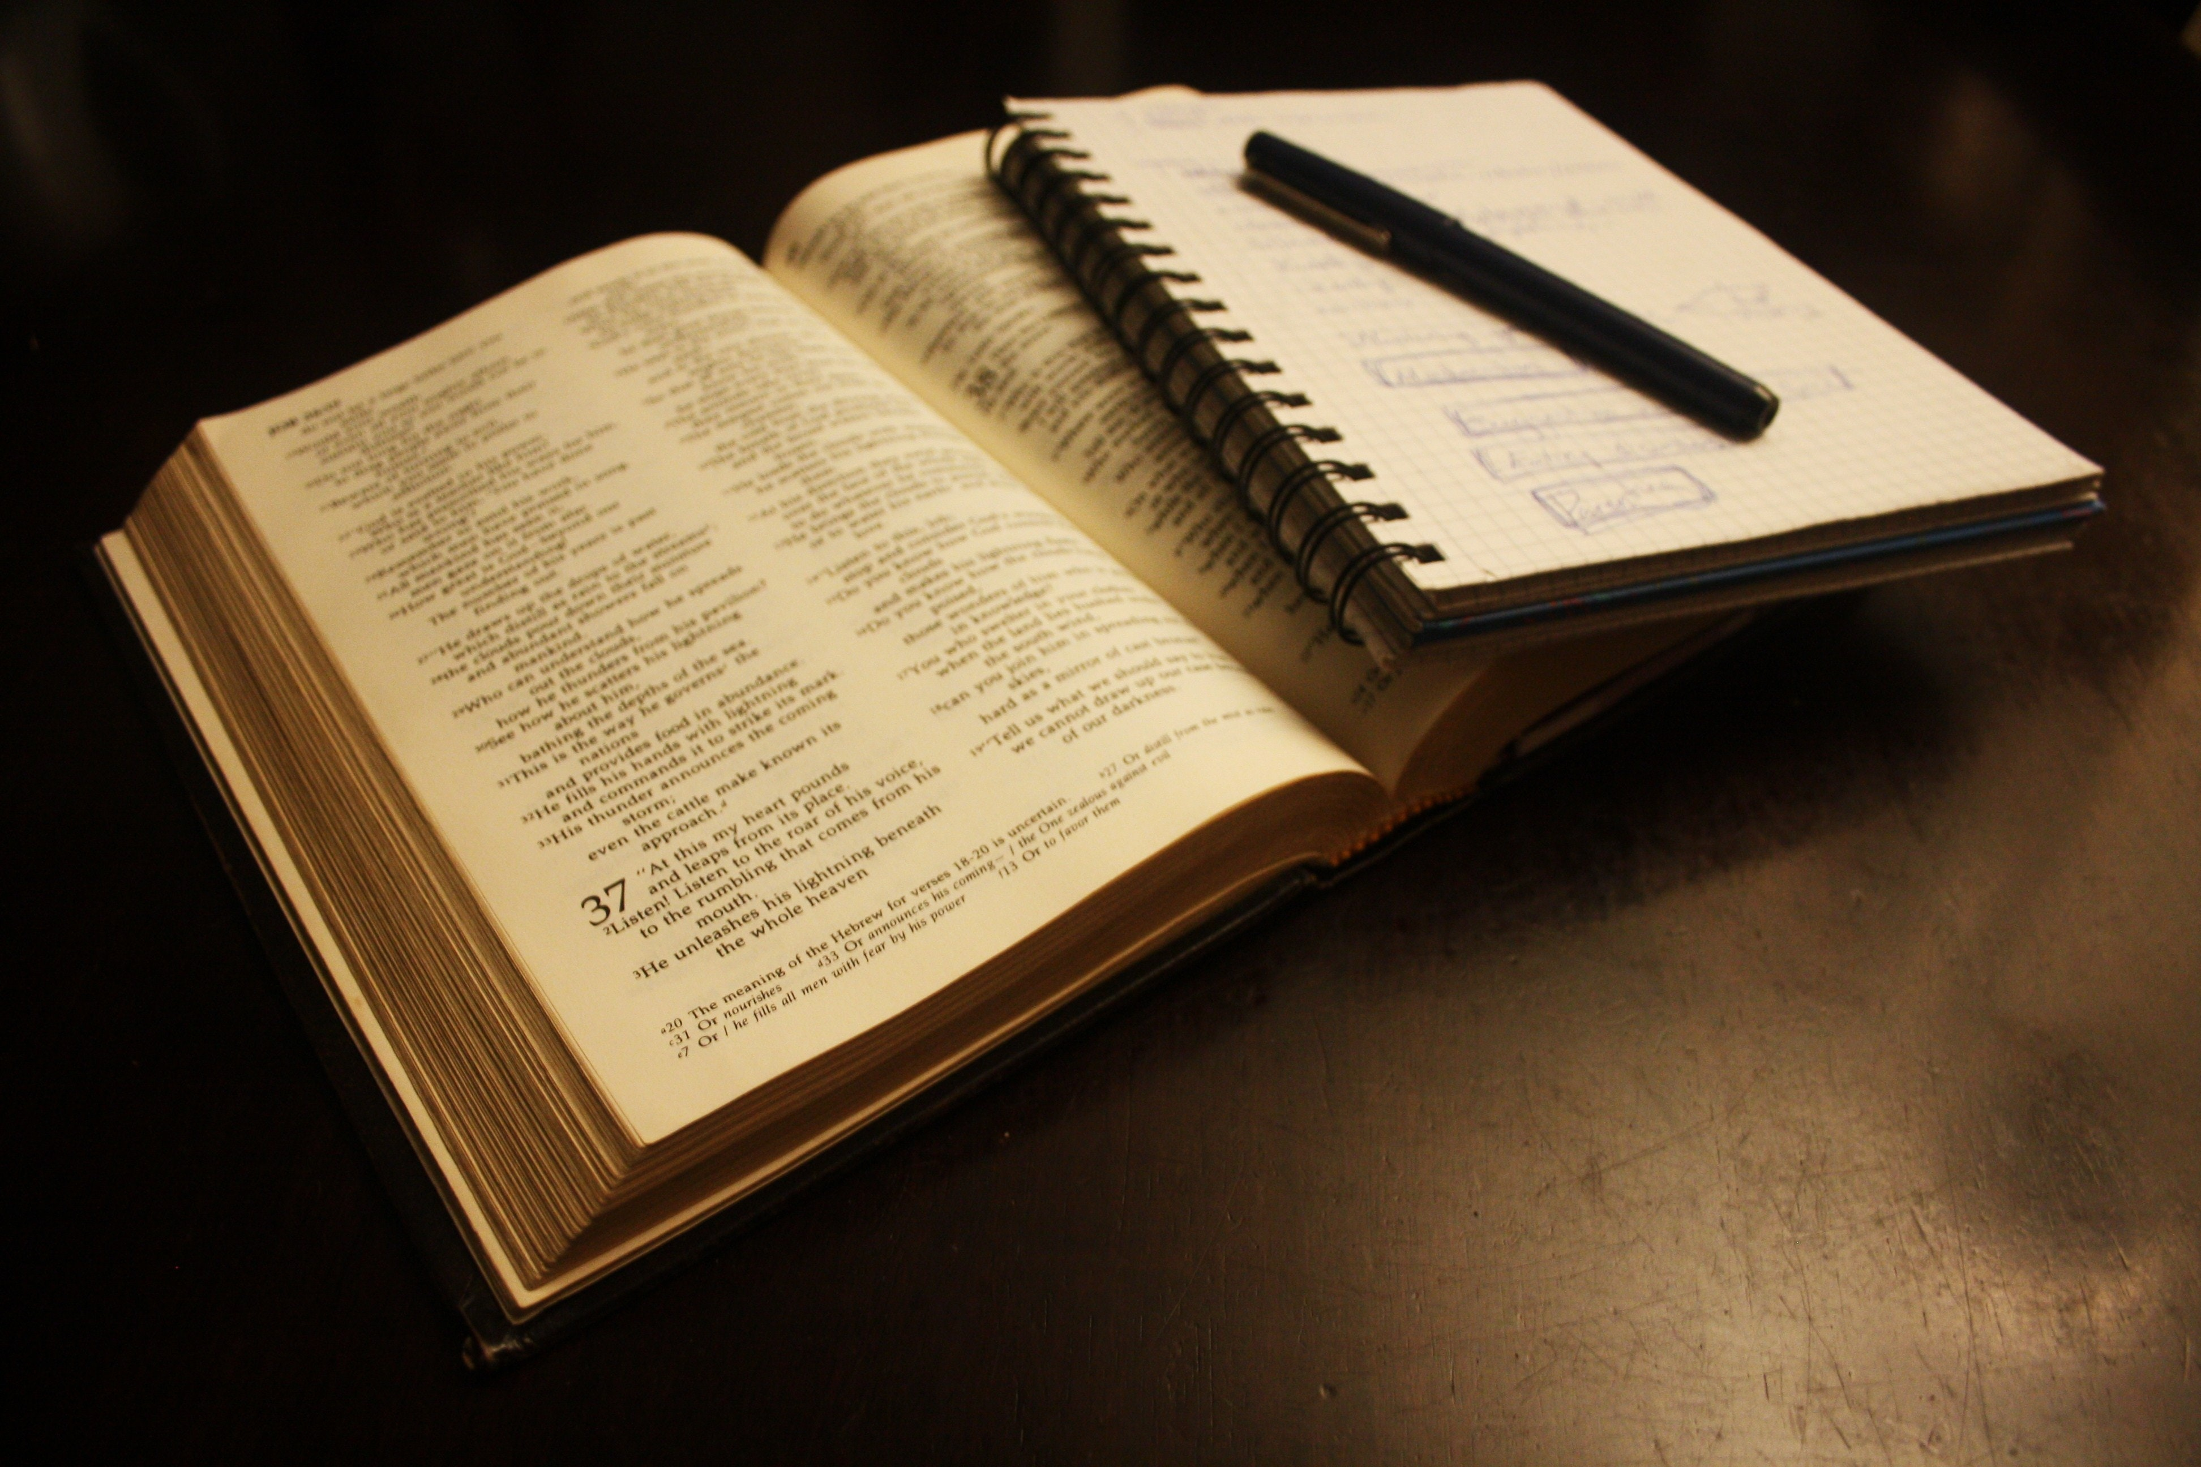
Daily Bible Readings
Monday: “Extending Mercy More Important than Sacrifice” (Matthew 12:1-8 )
Tuesday: “Love One Another from the Heart” (1 Peter 1:17-23)
Wednesday: “In Christ Gentiles Share Abraham’s Faith” (Galatians 3:6-9,13-14)
Thursday: “Faith of Levite Mother Saves Moses” (Exodus 2:1-10)
Friday: “Unexpressed Faith Has No Value” (James 2:14-17)
Saturday: “Faith and Works Complement Each Other” (James 2:18-26)
Sunday: “Disdain the Practice of Partiality” (James 2:1-13)

