Slide 1
Loving Your Neighbor
Reverend Dawn Salary
Second Baptist Church East End
Newport News, VA 23607

Slide 2
Loving Your Neighbor
Bible Background
Leviticus 19:18, 34; Luke 10:25-37
Printed Text
Luke 10:25-37
Devotional Reading
John 5:1-15

Slide 3
Aim for Change
EXPLORE
VALUE
SHARE
Share love and mercy with those who are in need, even those who are different from us
Value all people as God does
Explore the concept of neighbor in the conversation between Jesus and the lawyer

Slide 4
Keep in Mind
“‘Now which of these three would you say was a neighbor to the man who was attacked by bandits?’ Jesus asked.
The man replied, ‘The one who showed him mercy.’
Then Jesus said, ‘Yes, now go and do the same.’”
(Luke 10:36-37 NLT )

Slide 5
The Test (Luke 10:25-29)
What was the intention of the lawyer in asking Jesus the initial question?
How did Jesus respond?
What was the purpose of the second question that the lawyer asked Jesus?
How do you respond when others test your knowledge of the Word?
This Photo by Unknown Author is licensed under CC BY

Slide 6
The Parable (Luke 10:30-35)
What did Jesus do to illustrate how to be a good neighbor?
Why do you think the priest and the Levite avoided the wounded man?
Why did the Jews despise the Samaritans?
How can we best describe the Samaritan’s actions?
How can we be better neighbors especially during our current climate?
This Photo by Unknown Author is licensed under CC BY-SA

Slide 8
The Moral (Luke 10:36-37)
How did Jesus end the parable?
What was the lawyer’s response to Jesus?
Who is your neighbor?
This Photo by Unknown Author is licensed under CC BY-SA

Slide 9
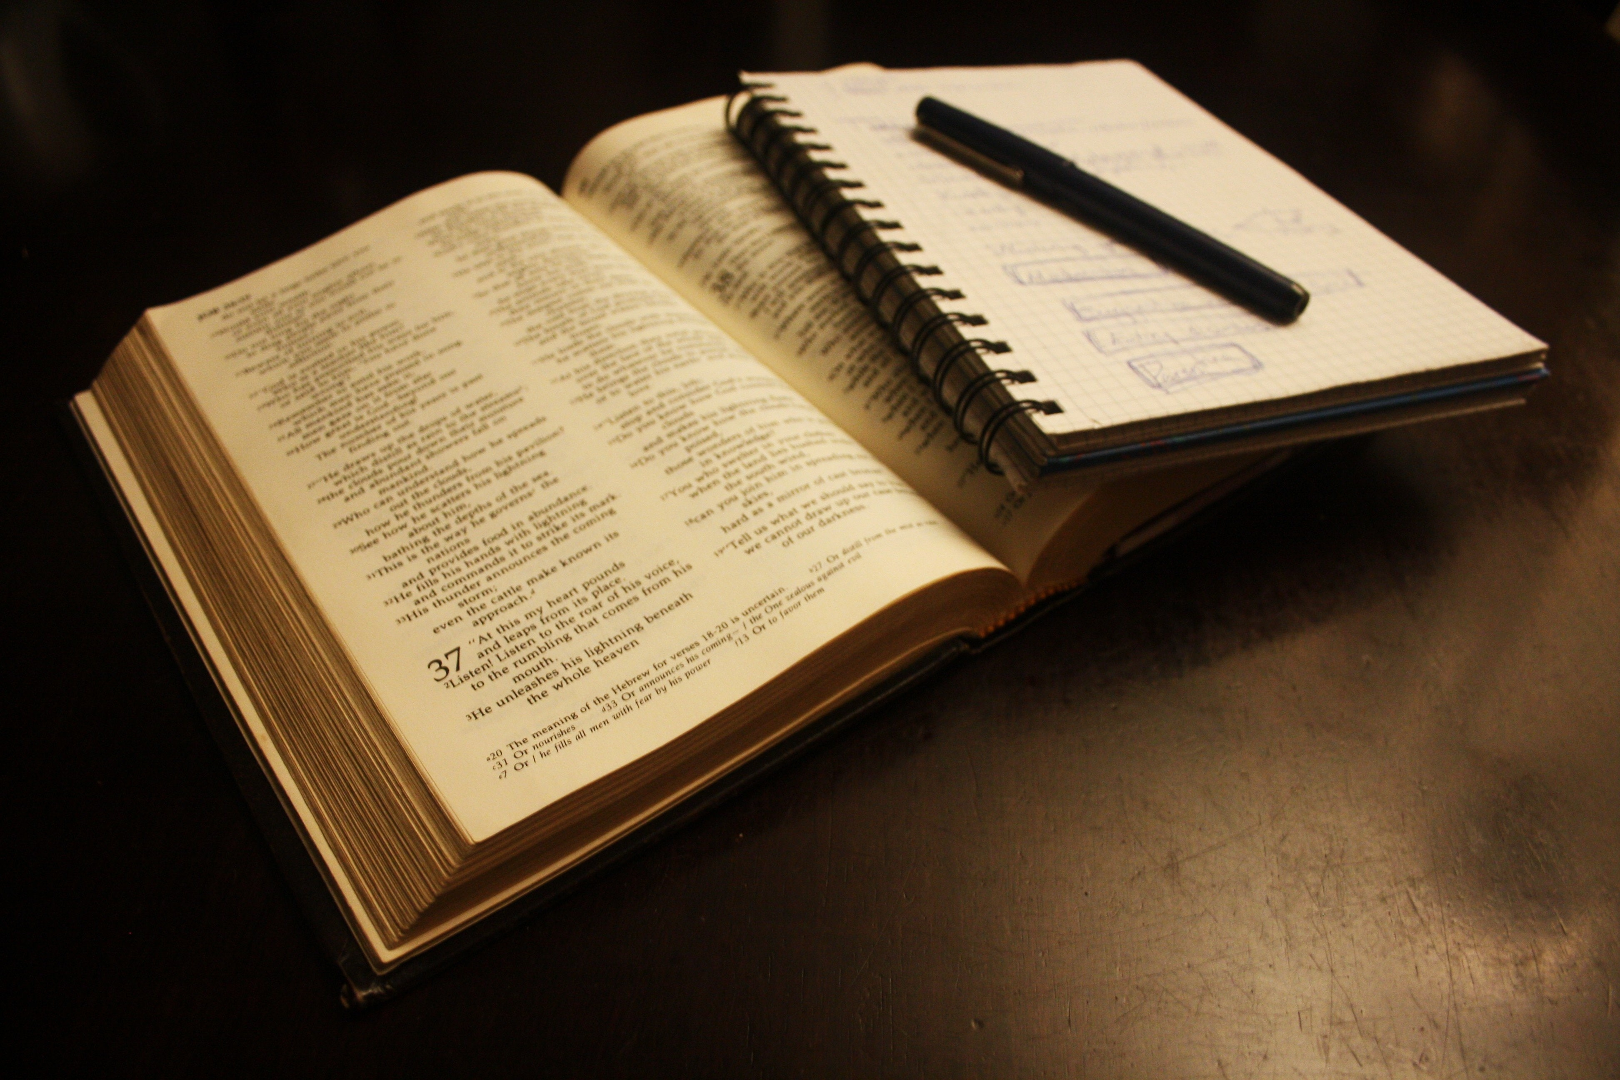
Daily Bible Readings
Monday: “Help Your Neighbor in Need” (Deuteronomy 15:7-11)
Tuesday: “Love God and Brothers and Sisters” (1 John 4:16-21)
Wednesday: “Adopt the First Commandments” (Mark 12:28-34)
Thursday: “Jesus Accepts Thanks from Healed Samaritan” (Luke 17:11-19)
Friday: “Jacob Lives with Joseph in Egypt” (Acts 7:9-15)
Saturday: “Jesus Offers Samaritan Woman Living Water” (John 4:1-15)
Sunday: “Follow the Samaritan’s Example” (Luke 10:25-37)

