Slide 1
Love and Devotion to Others
Rev. Dawn Salary
Second Baptist Church East End
Newport News, VA 23607

Slide 2
Love and Devotion to Others
Bible Background:
1 Samuel 19:1-7, 23:1-18;
2 Samuel 9
Printed Text:
1 Samuel 19:1-7
Devotional Reading:
Matthew 5:43-48

Slide 3
Aim for Change
EXPLORE
Explore the story of Jonathan’s defense of David when David was opposed by Saul
LONG
Long for love and justice within the family and beyond
GROW
Grow in love and devotion for justice for others

Slide 4
Keep in Mind
“The next morning Jonathan spoke with his father about David, saying many good things about him.
‘The king must not sin against his servant David,’ Jonathan said.
‘He’s never done anything to harm you. He has always helped you in any way he could.’”
(1 Samuel 19:4 NLT)

Slide 5
Love Tested (1 Samuel 19:1-3)
Based on what we know from previous chapters, why did Saul want David to be assassinated?
Based on what we know from previous chapters, how would you describe Saul’s character?
What did Jonathan do as a response to Saul’s urgings to kill David?
Why does Jonathan choose to have the conversation with his father in the field rather than in the throne room/court?

Slide 6
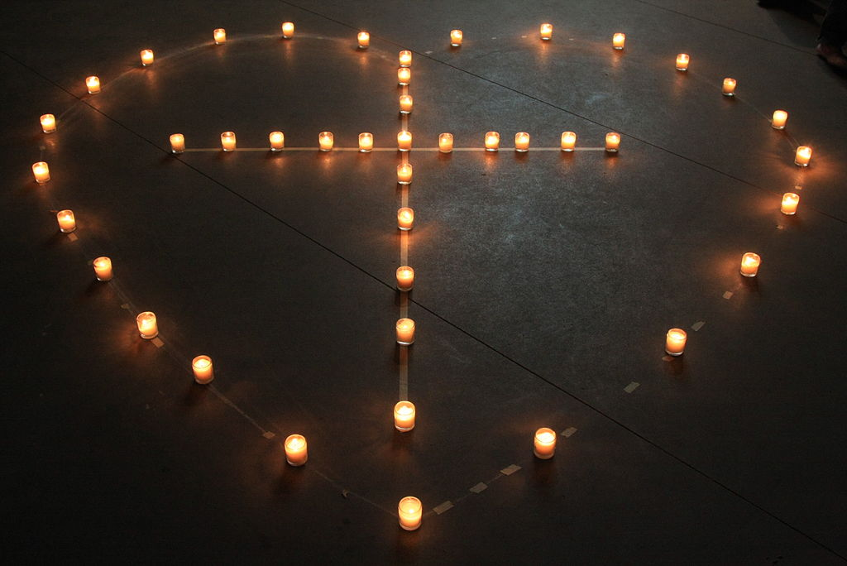
Love Intercedes (1 Samuel 19:4-7)
List the “many good things” that Jonathan said about David.
How did Saul respond to Jonathan’s defense of David?
What role(s) did Jonathan serve in this lesson?
What characteristics would you use to describe Jonathan?
This Photo by Unknown Author is licensed under CC BY-SA-NC

Slide 7
Daily Bible Readings
MONDAY: “Timothy, My Brother and Co-Worker” (1 Thessalonians 3:1-6)
TUESDAY: “David Slays Philistine with a Stone” (1 Samuel 17:41-51)
WEDNESDAY: “David and Jonathan Bond Together” (1 Samuel 18:1-5)
THURSDAY: “Saul Jealous of and Fears David” (1 Samuel 18:12-18)
FRIDAY: “Jonathan Asserts David as Next King” (1 Samuel 23:14-18)
SATURDAY: “David Provides for Jonathan’s Son Mephibosheth” (2 Samuel 9:1-10)
SUNDAY: “Saul Promises to Preserve David’s Life” (1 Samuel 19:1-7)
This Photo by Unknown Author is licensed under CC BY

