Slide 1
Love Versus Guilt
Rev. Dawn Salary
Second Baptist Church East End
Newport News, VA 23607

Slide 2
Love Versus Guilt
Bible Background:
Genesis 42
Printed Text:
Genesis 42:6-25
Devotional Reading:
Psalm 51
This Photo by Unknown Author is licensed under CC BY-NC-ND

Slide 3
Aim for Change
EXPLAIN
Explain why Joseph’s brothers interpreted their misfortune as punishment for their sins
SENSE
Sense the need for wholeness in our personal relationships
IDENTIFY
Identify ways to accept God’s forgiveness and strive to offer grace to those who mistreat us

Slide 4
Keep in Mind
“‘Didn’t I tell you not to sin against the boy?’ Reuben asked. ‘But you wouldn’t listen. And now we have to answer for his blood.’”
(Genesis 42:22 NLT)

Slide 5
Background
Joseph was summoned to interpret the Pharaoh’s dreams
Pharaoh puts Joseph in charge of all of Egypt
Joseph marries Asenath/has two sons (Manasseh & Ephraim)
Seven years of prosperity have come and gone
Famine struck all of the surrounding countries of Egypt
This Photo by Unknown Author is licensed under CC BY-NC-ND

Slide 6
Confronting Shame (Genesis 42:6-8)
“shallit” (Hebrew for “governor”) – a ruler or person in a position of honor
What was Joseph’s response to his brothers when they approached him to buy grain?
Why were the brothers unable to recognize Joseph?
This Photo by Unknown Author is licensed under CC BY-NC

Slide 7
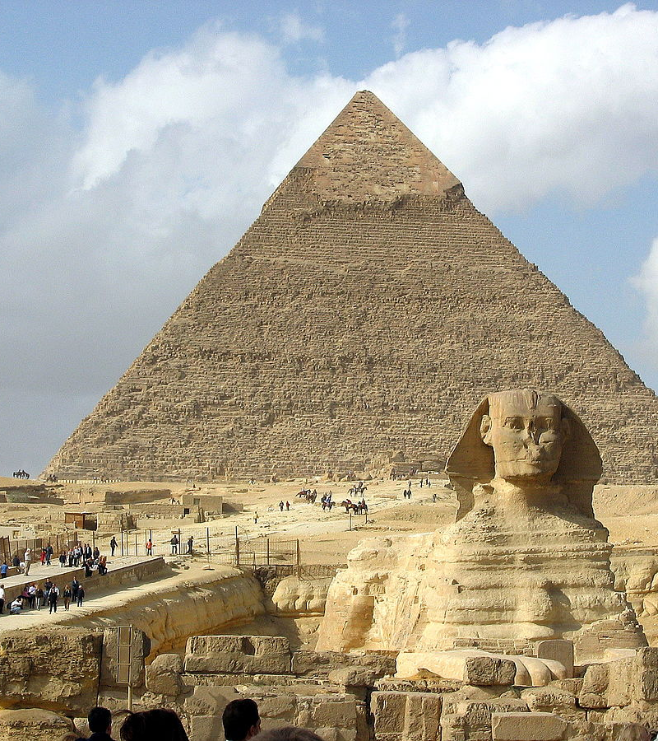
Confronting Opportunity (Genesis 42:9-17)
Why did Joseph accuse the brothers of being spies?
Why did Joseph put the brothers in prison for three days?
This Photo by Unknown Author is licensed under CC BY-SA

Slide 8
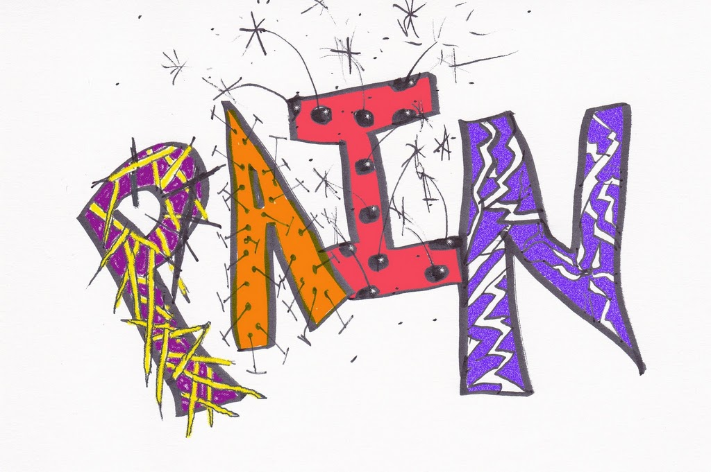
Confronting Pain (Genesis 42:18-22)
Why did Joseph tell his brothers that he was a God-fearing man?
Initially, Joseph intended to keep nine brothers in prison. Why did he change his mind?
How can we get to the place to be able to extend grace to those who have caused us pain?
In your own words, what was Reuben’s message to his brothers?
This Photo by Unknown Author is licensed under CC BY-NC

Slide 9
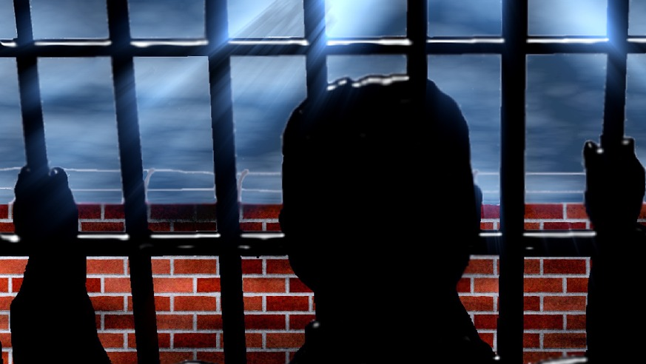
Confronting with Mercy (Genesis 42:23-25)
Why did Joseph weep?
Which brother was held in prison while the others returned to Canaan? Why?

Slide 10
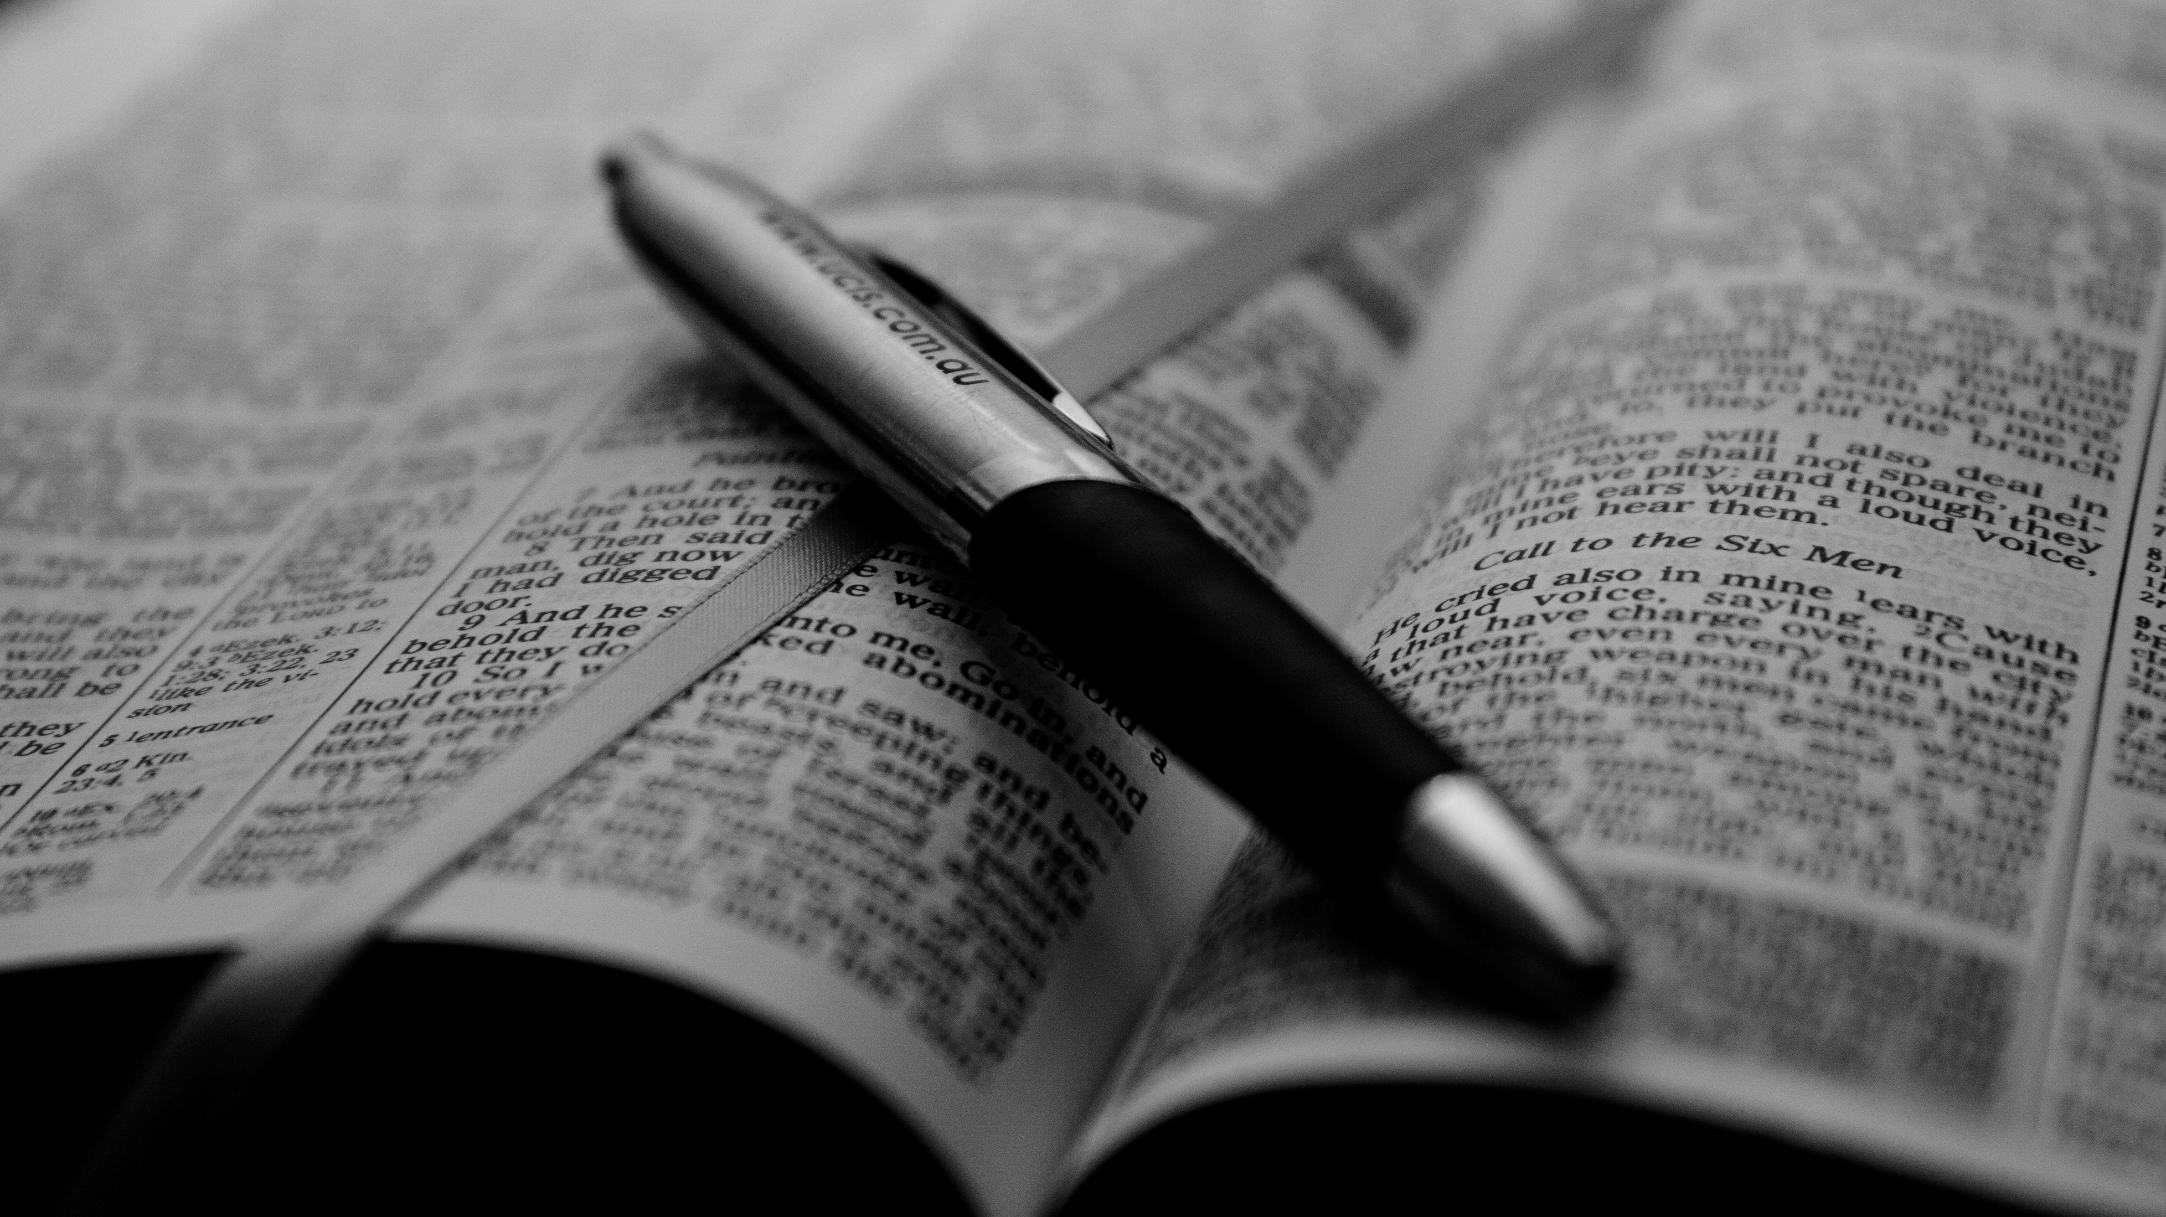
Daily Bible Readings
MONDAY: “Have Mercy on Me, a Sinner” (Psalm 51:1-12)
TUESDAY: “Pilate’s Judgment of Jesus, ‘Not Guilty’” (Luke23:9-15)
WEDNESDAY: “Brothers Sent to Egypt to Buy Grain” (Genesis 42:1-5)
THURSDAY: “Joseph Returns Money with Grain” (Genesis 42:26-28)
FRIDAY: “Joseph Questions Motives of Brothers” (Genesis 41:41-49)
SATURDAY: “Jacob Vows Not to Send Benjamin” (Genesis 42:35-38)
SUNDAY: “Joseph Confronts Brothers for Past Behavior” (Genesis 42:6-25)
This Photo by Unknown Author is licensed under CC BY

