Slide 1
Hearing and Doing the Word
Rev. Dawn Salary
Second Baptist Church East End
Newport News, VA 23607

Slide 2
Hearing and Doing the Word
Bible Background:
James 1:19-27
Printed Text:
James 1:19-27
Devotional Reading:
1 Corinthians 1:26-31
This Photo by Unknown Author is licensed under CC BY-NC-ND

Slide 3
Aim for Change
REALIZE
Realize the proof of wisdom is not just in what we say, but what we do
EXPRESS
Express compassion for those who are most vulnerable and desire to act on their behalf
ENGAGE
Engage in ministry that demonstrates the religion that James describes

Slide 4
Keep in Mind
“But be ye doers of the word, and not hearers only, deceiving your own selves”
(James 1:22 KJV)
“But don’t just listen to God’s word. You must do what it says. Otherwise, you are only fooling yourselves.
(James 1:22 NLT)

Slide 5
Quick Review
Faith and Wisdom (James 1:1-11)
Author/Audience
Diaspora – the movement, migration, or scattering of a people away from an established or ancestral homeland
Read James 1:12-18 in your spare time (verses omitted)

Slide 6
Steps of Temptation (James 1:13-15)
Comes from our own desires
These desires entice us and drag us away
As a result of our desires, we commit sin.
When sin is allowed to grow, it gives birth to death.

Slide 7
Behaving the Word (James 1:19-20)
How does James advise believers to behave?
What is the “righteousness that God desires/righteousness of God” as mentioned in verse 20?
According to James, human anger does not produce the righteousness of God. Why not?

Slide 8
Living by the Word (James 1:21-25)
What’s considered to be filth/evil in our lives?
How do we humbly/meekly accept the Word that has been planted/engrafted in our hearts?
How is hearing the Word and not “doing” the Word related to looking at yourself in a mirror?

Slide 9
Representing the Word (James 1:26-27)
“chalinagogeo” (Greek for “bridleth”) – means “to hold in check or restrain”
What is meant by “seem to be religious” or “claim to be religious” in verse 26?
According to James, what is pure/genuine religion? Is it the same in our current culture?
How can we keep ourselves unspotted from the world/uncorrupted by the world as mentioned in verse 27?

Slide 10
Application for Activation
Listen for God’s instruction through the preached Word, in your time of devotion, Bible Study, etc.
Take time to be quiet before the Lord/write down what the Holy Spirit reveals to you
Make a conscious effort to assess habits, behaviors, and actions that do not line up with the Word of God
Repent and ask the Holy Spirit to help you behave differently
Be patient with yourself
Trust that God has heard you and that His Word will change your heart if you yield to His way.

Slide 11
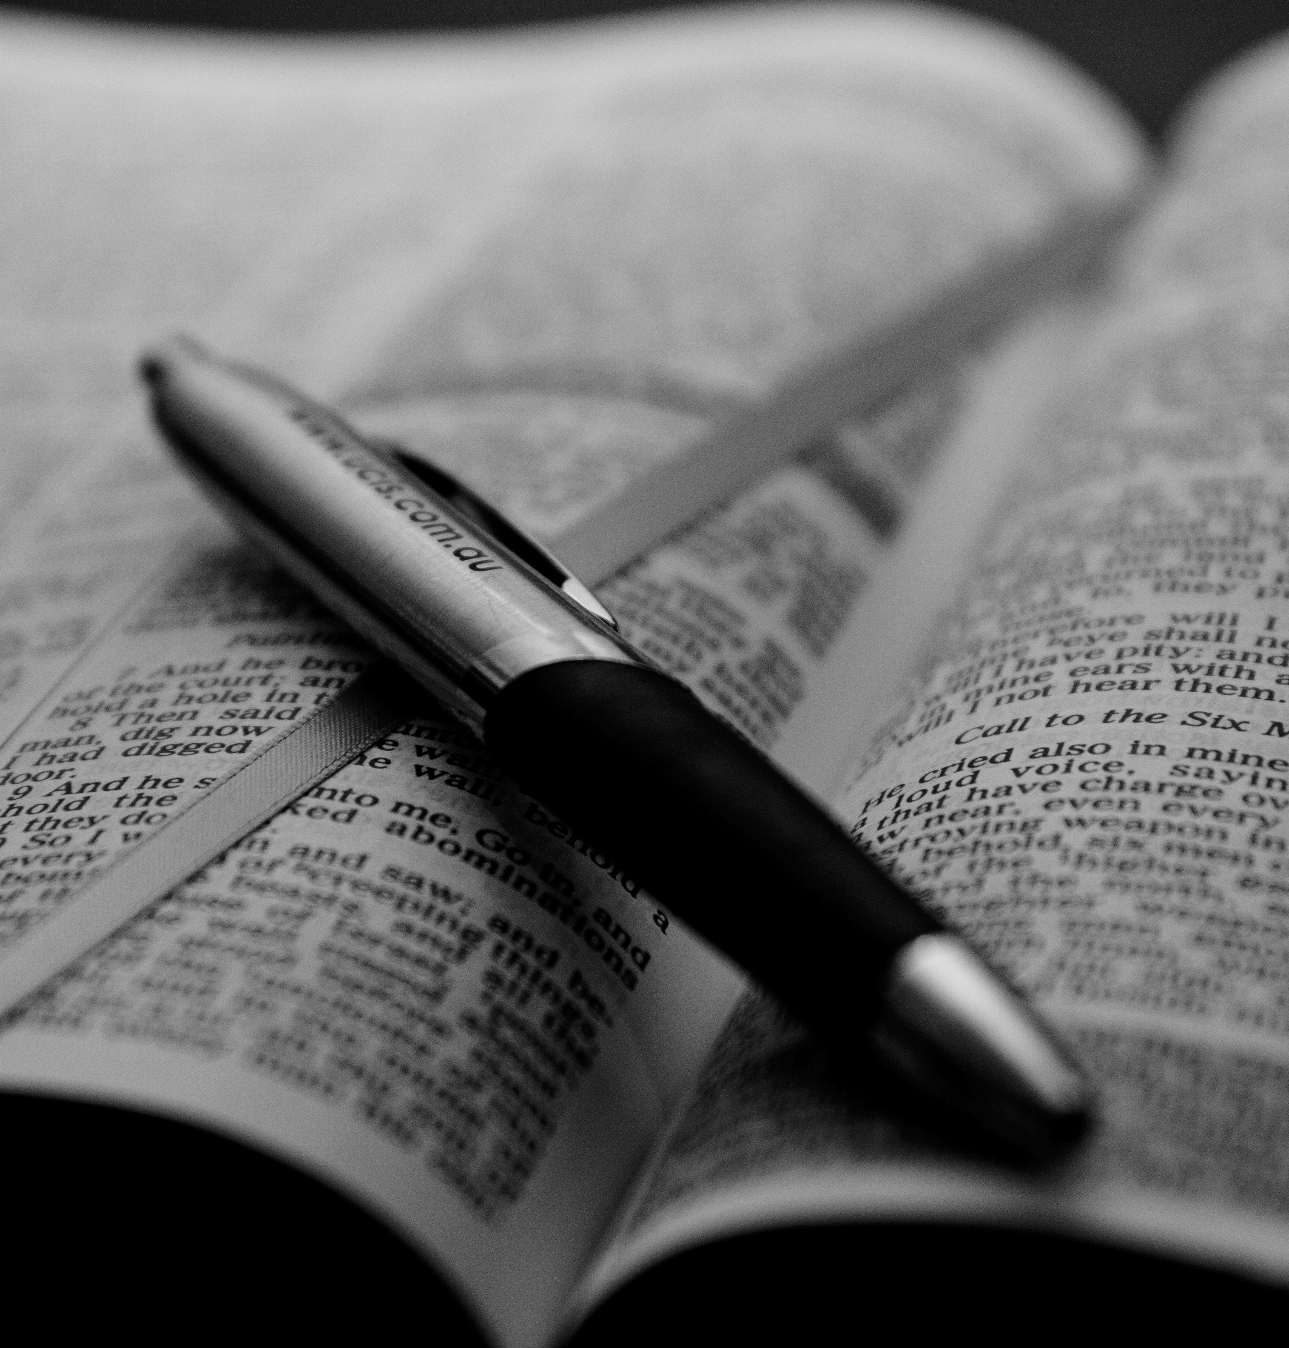
Daily Bible Readings
MONDAY: Impartial Relationships with One Another”(Leviticus 19:13-18)
TUESDAY: “Praised for Steadfast Faith in Persecution (2 Thessalonians 1:3-5, 11-12)
WEDNESDAY: “The Poor Blessed; the Rich Criticized” (Luke 6:20-26)
THURSDAY: “Suffering for Doing the Right Thing” (1 Peter 3:13-19)
FRIDAY: “God’s Choice – the Foolish, Weak, Lowly” (1 Corinthians 1:26-31)
SATURDAY: “Treat the Rich and Poor Impartially” (James 2:1-7)
SUNDAY: “The Wise Hear and Do Good” (James 1:19-27)
This Photo by Unknown Author is licensed under CC BY

