Slide 1
Faith and Wisdom
Rev. Dawn Salary
Second Baptist Church East End
Newport News, VA 23607

Slide 2
Faith and Wisdom
Bible Background:
James 1:1-11
Printed Text:
James 1:1-11
Devotional Reading:
Isaiah 40:1-8
This Photo by Unknown Author is licensed under CC BY-NC-ND

Slide 3
Aim for Change
CONSIDER
Consider the relationship between wisdom and perseverance through trials
AFFIRM
Affirm the value of trials and hardships in making us more wise and productive disciples
PRAY
Pray for Godly wisdom by which to endure life’s trials and temptations

Slide 4
Keep in Mind
“If you need wisdom, ask our generous God, and He will give it to you.
He will not rebuke you for asking.”
(James 1:5 NLT)

Slide 5
Background (James 1:1)
Author/Audience
Diaspora – the movement, migration, or scattering of a people away from an established or ancestral homeland

Slide 6
Joy in the Midst of Trial and Difficulty (James 1:2-4)
“Peripipto” (Greek word for “fall into”) – means “surrounded by”
Peirasmos (Greek word for “temptations”) – means “trials that have a goal in mind”
Why should we count our trials as joy? How do we do that?
What does it mean to be perfect, complete, and needing nothing?

Slide 7
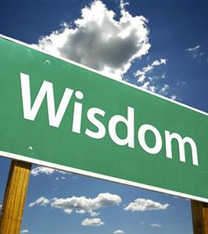
The Way to Wisdom (James 1:5-8)
Wisdom (Greek word is “sophia”) – means more than mere knowledge
What is meant by a person with divided loyalty/having “double-mindedness” (KJV)?
This Photo by Unknown Author is licensed under CC BY-SA-NC

Slide 8
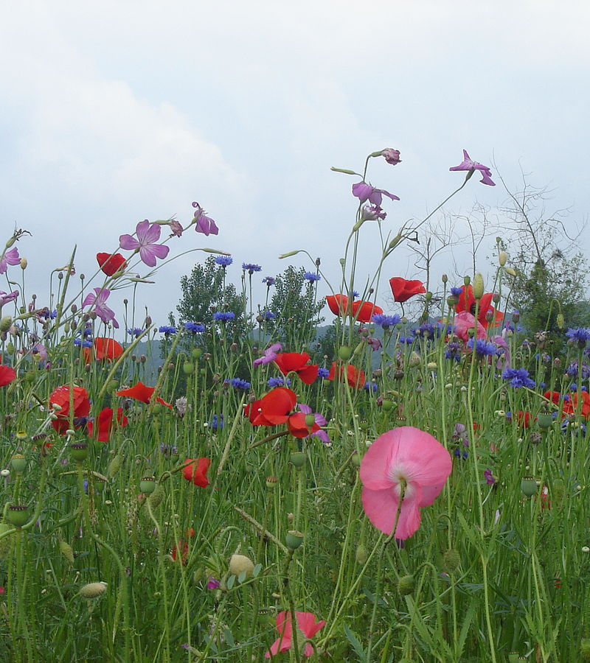
The Poor Shall Be Raised (James 1:9-11)
What’s the overall message for the poor and the wealthy in comparison to the flowers and the grass?
What’s the “wisdom” component of verses 9-11?
This Photo by Unknown Author is licensed under CC BY-SA

Slide 9
Daily Bible Readings
MONDAY: “Suffering on Behalf of the Church” (Colossians 1:24-29)
TUESDAY: “Saved by God’s Mercy” (Titus 3:3-7)
WEDNESDAY: “Ask: God Will Supply Your Needs” (Luke 11:9-13)
THURSDAY: “Rejoice in Your Sufferings” (Romans 5:1-5)
FRIDAY: “God’s Loving Actions Toward Sinners” (Romans 5:6-11)
SATURDAY: “Grass Withers But God’s Word Stands” (Isaiah 40:1-8)
SUNDAY: “Wisdom Overcomes Trials and Temptations” (James 1:1-11)
This Photo by Unknown Author is licensed under CC BY

